Slide 1
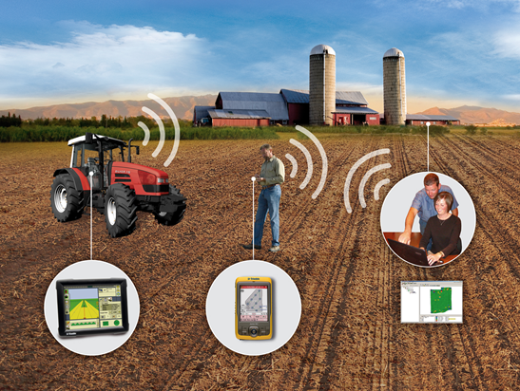
Precision
Agriculture
David Mulla,
Director Precision Ag Center
University of Minnesota

Slide 2
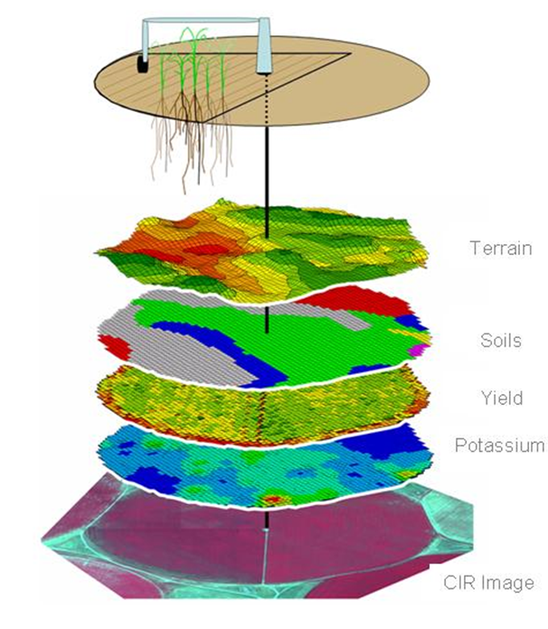
What is Precision Agriculture?
A management practice applied at the right rate, right time, and right place
  Customized field management
  Nutrients
  Drainage or irrigation
  Insects and weeds
  Tillage and seeding operations

Slide 3
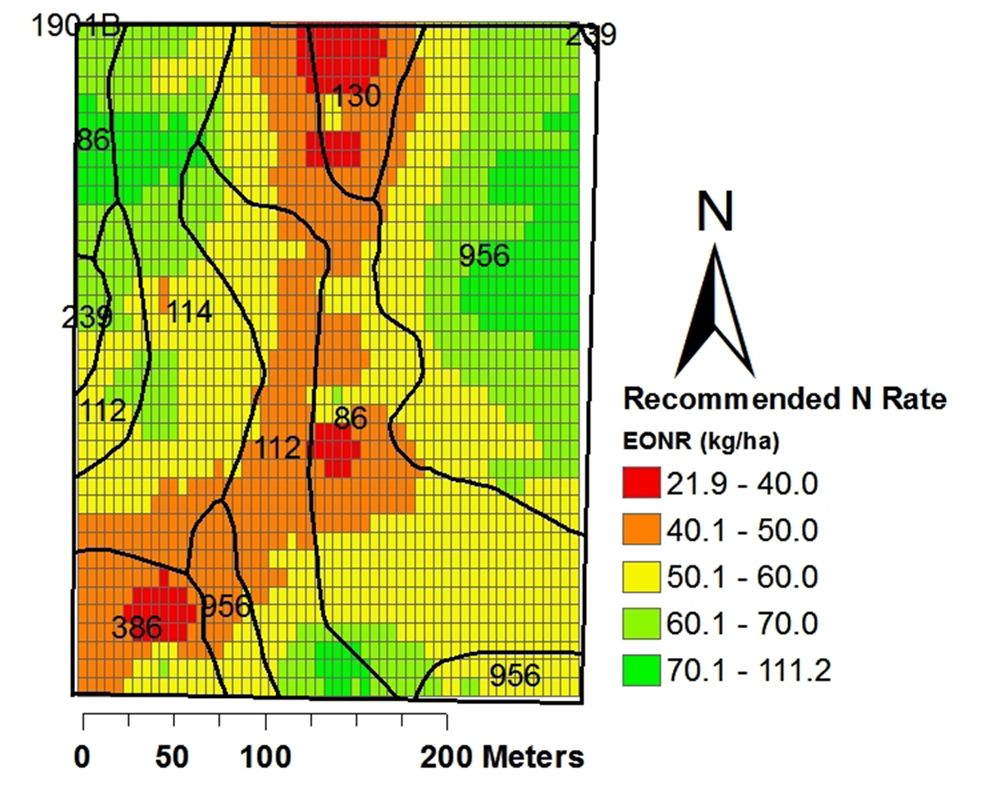
Benefits of Precision Agriculture
Increased profitability
Increased efficiency of inputs
Reduced environmental pollution

Slide 4
Conventional Agriculture
Uniform management based on
  Average field conditions
  Best field conditions
Uniform management ignores spatial and temporal variability in crop growth and soil or landscape features
It leads to overuse of farm inputs

Slide 5
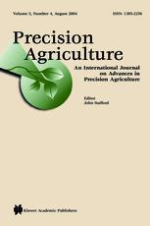
U of M is a Leader in
Precision Agriculture
Precision Agriculture was developed at the U of M in the early 1980s
U of M founded the International Conference on Precision Agriculture in 1992
The first Precision Agriculture Center in the world was established at the U of M in 1995
U of M founded the Precision Agriculture journal in 2000

Slide 6
Multidisciplinary Collaboration Drives Precision Agriculture
Precision Agriculture research at the U of M involves over twenty faculty members from CFANS (6 depts.) and CSE (2 depts.), and the Waseca, Lamberton, and Crookston Research and Outreach Centers
NSF, USDA and MN Agencies/Legislature have provided major funding for Precision Agriculture at U of M
  MnDrive, AGREET enabled hiring new Precision Agriculture faculty
  Robotics Sensors and Manufacturing Center in CSE
Strong history of international collaboration

Slide 7
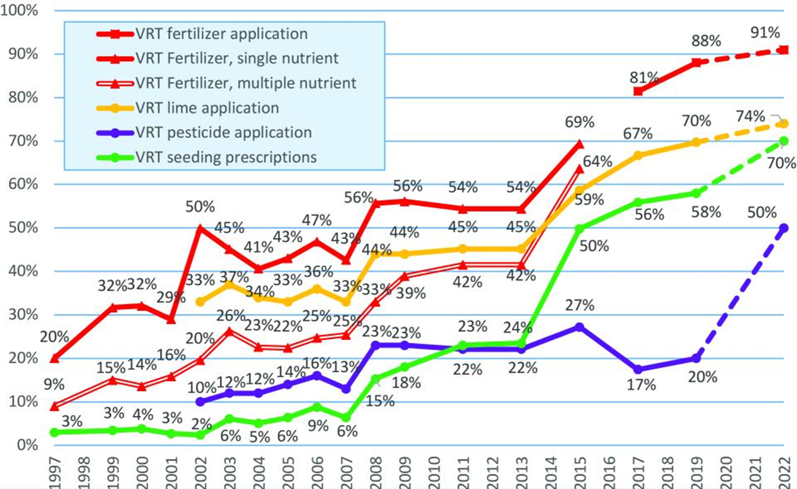
Precision Farming Management Examples
Tractor auto steer
Yield mapping
Variable rate fertilizer
Variable rate irrigation
Variable rate herbicide
Variable rate seeding
Grid or management zone soil sampling
Adoption rates vary from 20% to 90%,
depending on practice.
CropLife-Purdue Univ. survey 2019

Slide 8
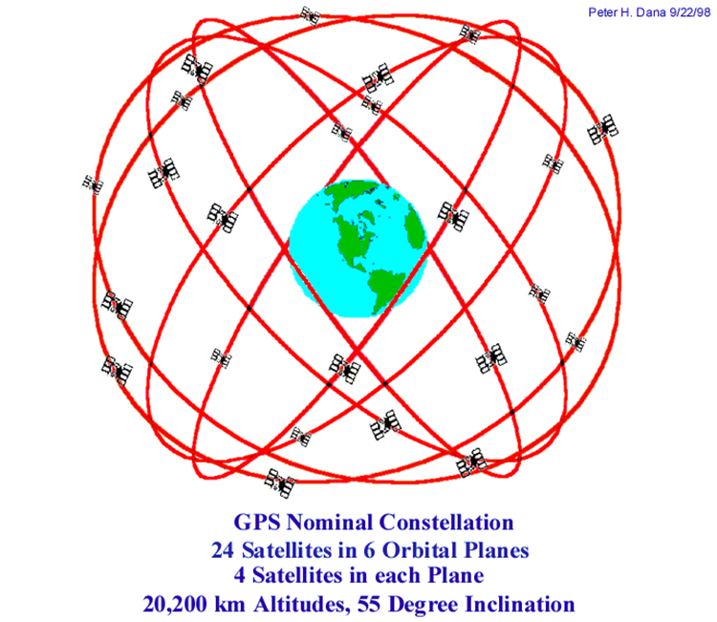
Precision Agriculture is High Tech!
Global Position Satellites
GIS and mapping software
Yield monitors
Computer modeling
Remote sensing
Proximal sensors
Digital soil and elevation maps
Deep learning algorithms, Big Data
Specialized farm equipment, drones and robots

Slide 9
Precision Agriculture: Example Impacts
Variable Rate Nitrogen (VRN) for improved surface water quality
Soybean aphid detection
Nitrogen and irrigation management for ground water protection
University-Industry collaboration
Job creation and workforce development
Extension and Outreach to agribusiness and growers

Slide 10
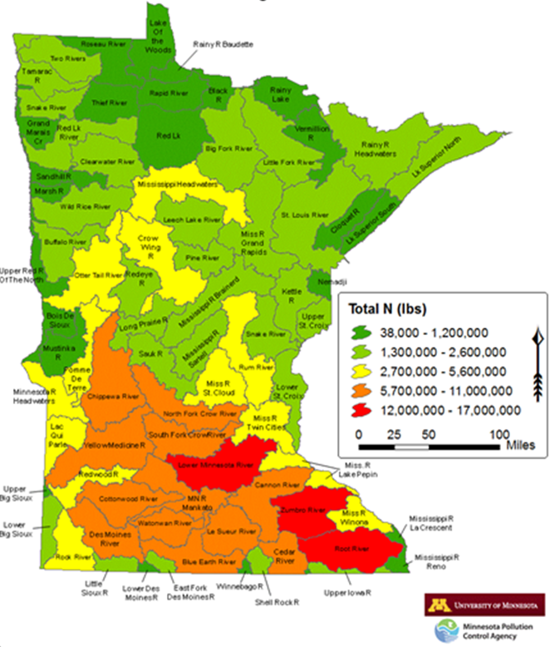
Nitrate Contamination of Surface Waters
High nutrient losses from southern Minnesota are due to:
High fertilizer and manure application rates on corn, and mineralization of soil organic matter
Precipitation patterns that cause leaching and loss of nitrate through subsurface drain tiles
Long-term goals to reduce nitrate-N loads include a 45% reduction, Minnesota interim target is 20% by 2025

Slide 11
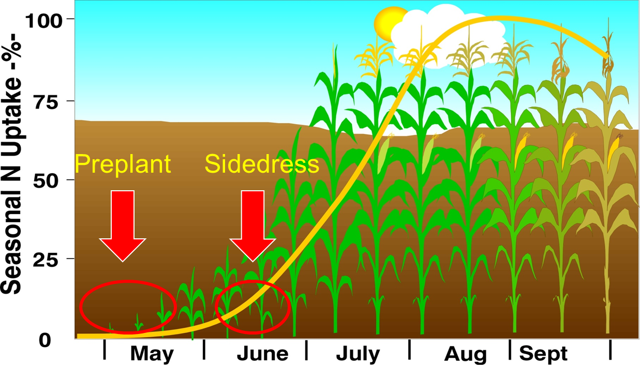
Variable Rate Nitrogen (VRN)
Match side-dress N fertilizer application to crop growth patterns
Use remote sensing to detect N deficiency in leaves

Slide 12
Variable Rate Nitrogen Research Objectives
To utilize remote sensing to determine the need for in-season variable rate N-fertilizer applications
To assess agronomic and environmental outcomes from management

Slide 13
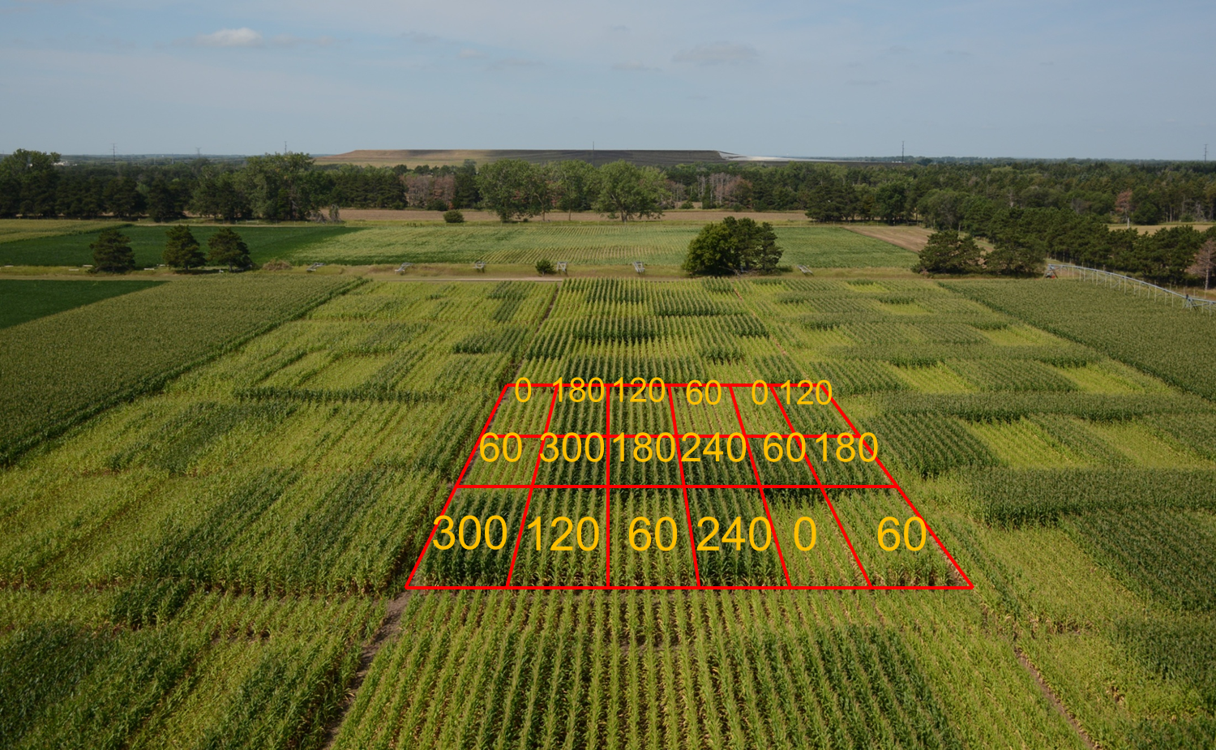
Variable Rate N Research in Maize

Slide 14
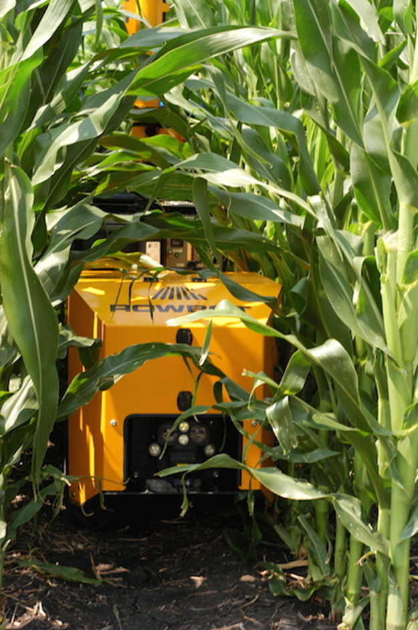
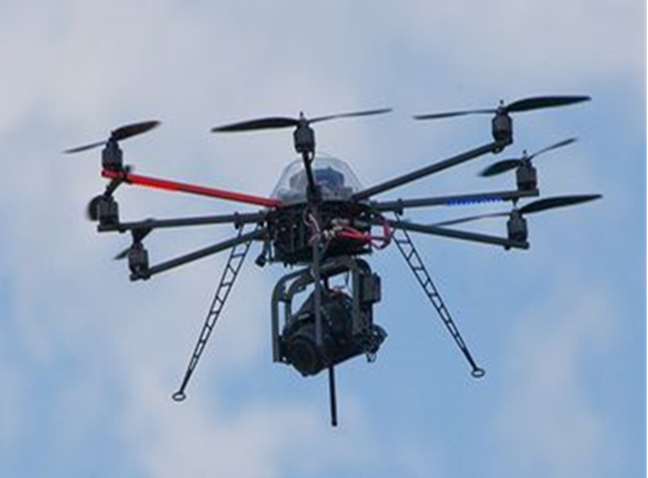
Robotics in Precision Agriculture
Unmanned ground vehicles (UGV)
Unmanned aerial vehicles (UAV)
Use of UAVs in Minnesota agriculture could lead to a thousand new jobs and nearly $150 million being pumped into the economy. (Dept. Employment Econ. Development)

Slide 15
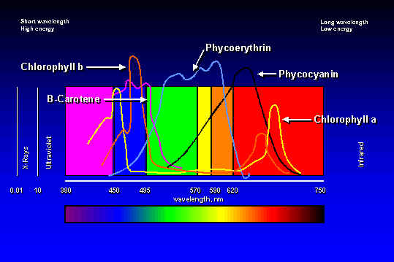
Visible Absorption Spectrum
Notes:
Pigments absorb light in wavelength dependent regions.

Slide 16
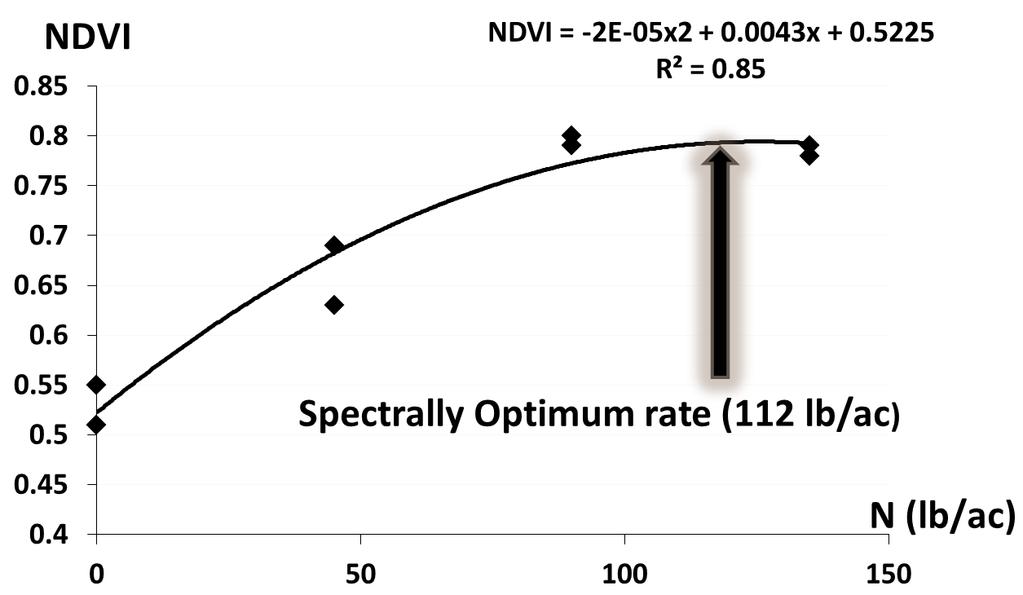
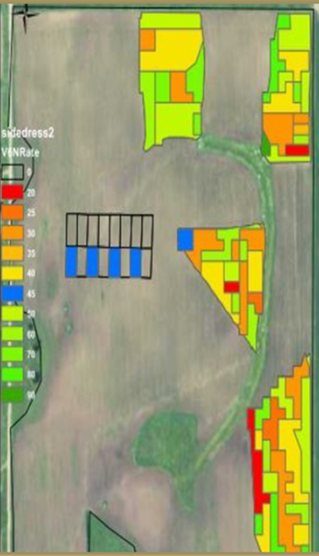
VRN Corn N Fertilizer Rate
Add 50 lb/ac
VRN Rate
(62 lb/ac)

Slide 17
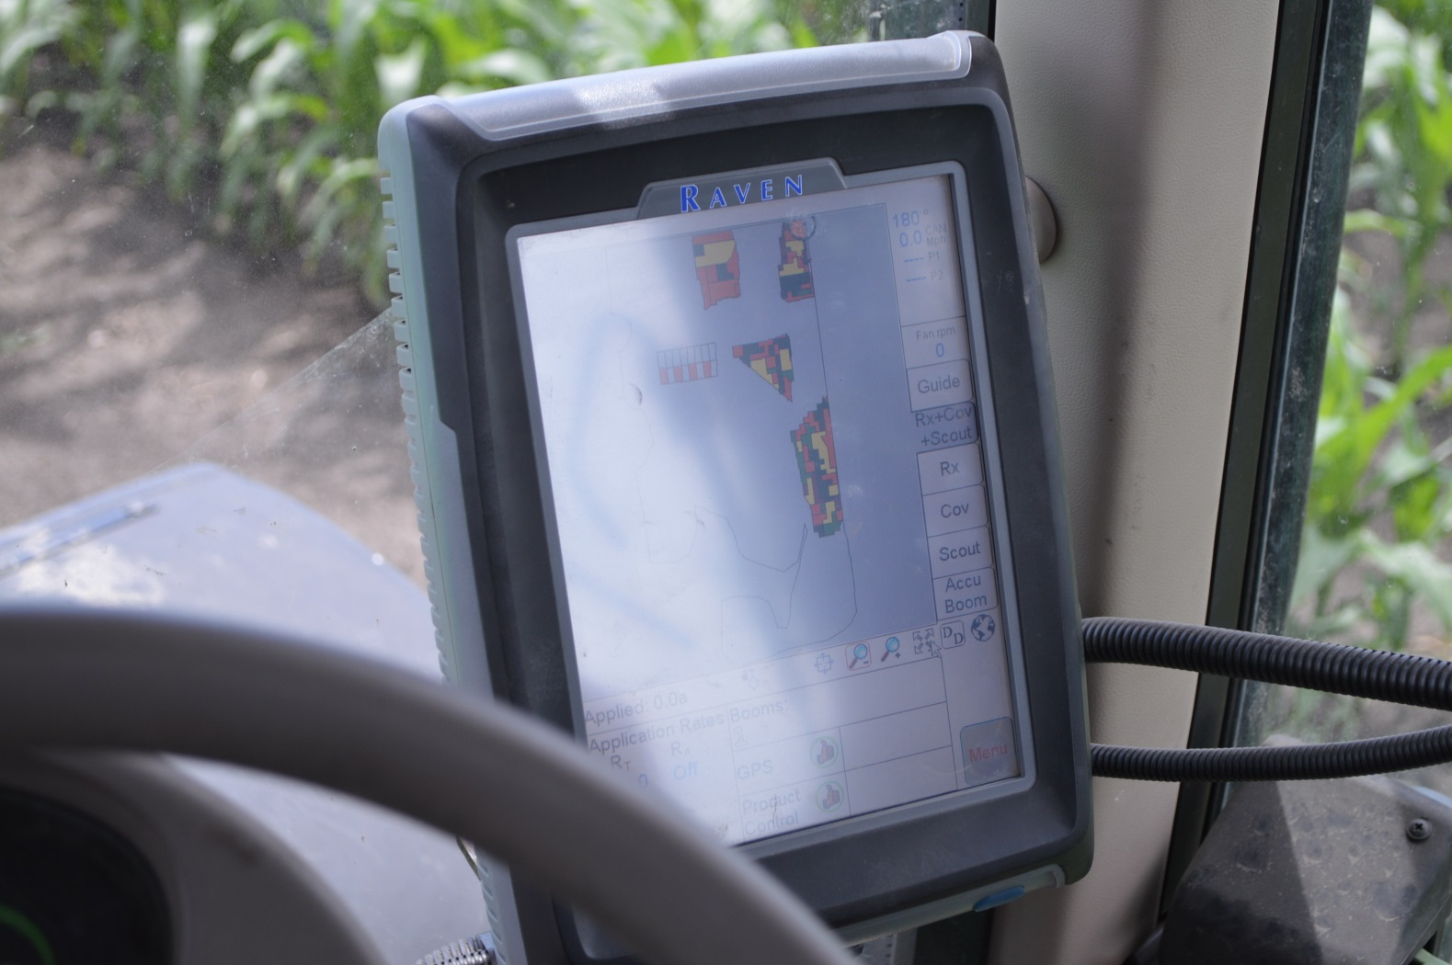
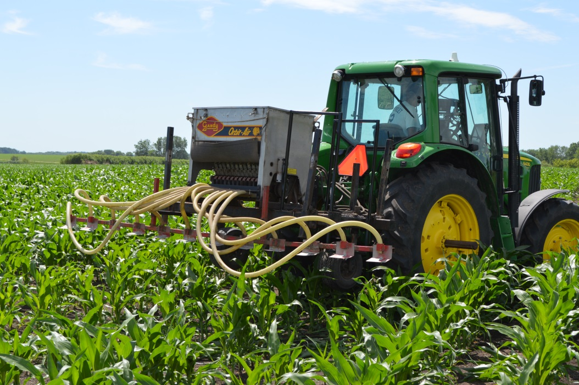
VRN Fertilizer Side-Dressing at V6-V7
Raven Controller
Toolbar

Slide 18
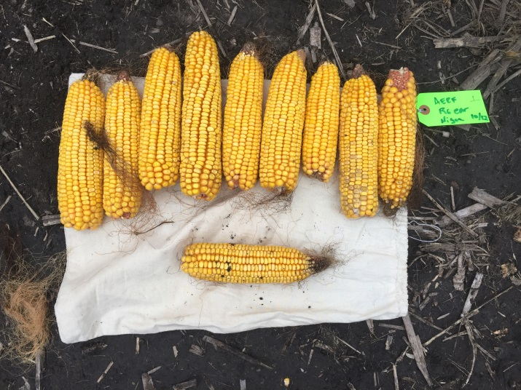
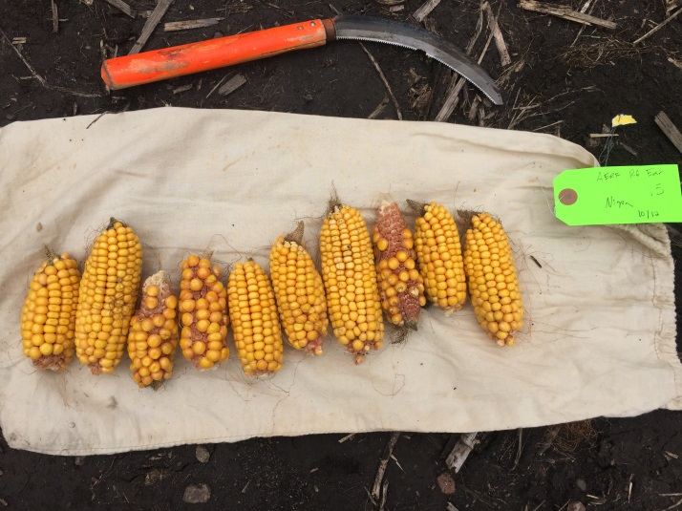
Impacts of VRN on Yield and N Fertilizer Use
VRN subfields in green received 20-30% less N than uniform subfields, with no significant impact on yield (2016-2017)
120 lb N/ac
Control

Slide 19
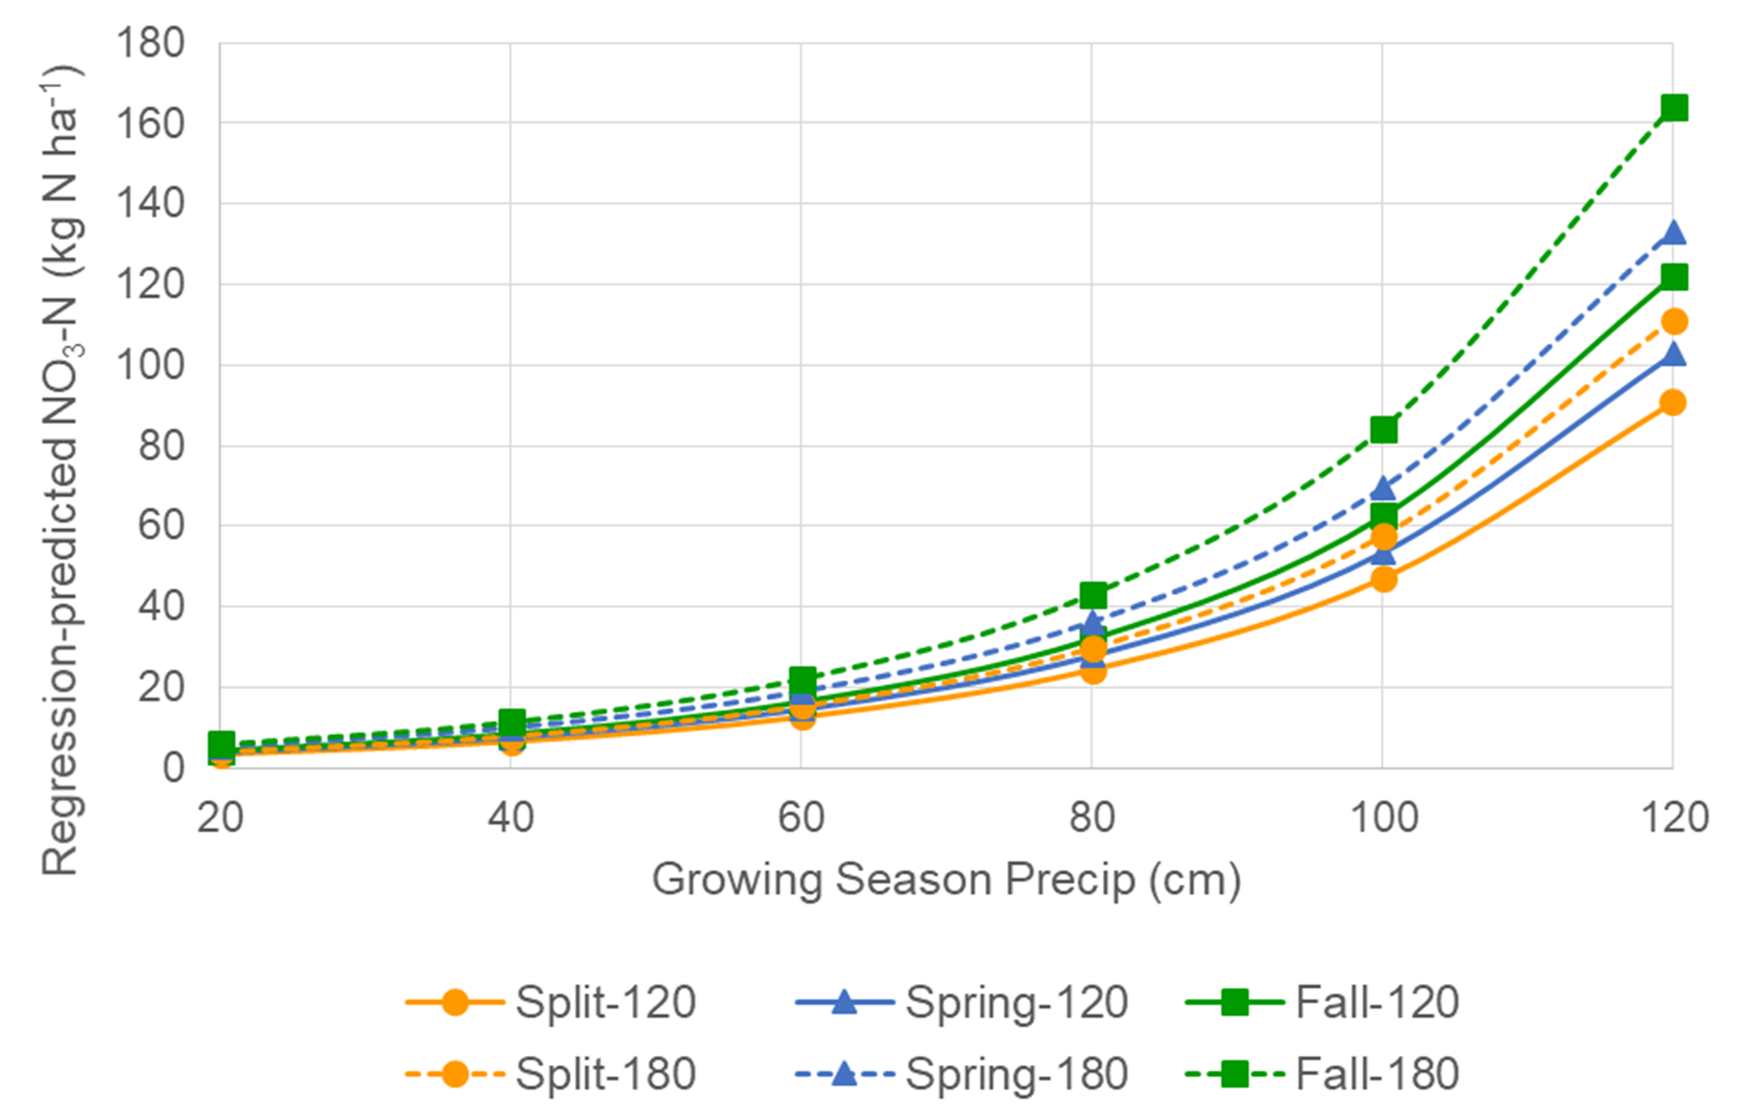
Regional Benefits of Variable Rate N on Water Quality: Nitrate Losses to Subsurface Tile Drains
45%
Reduction
in Wet Years
30% Reduction
in Normal Year

Slide 20
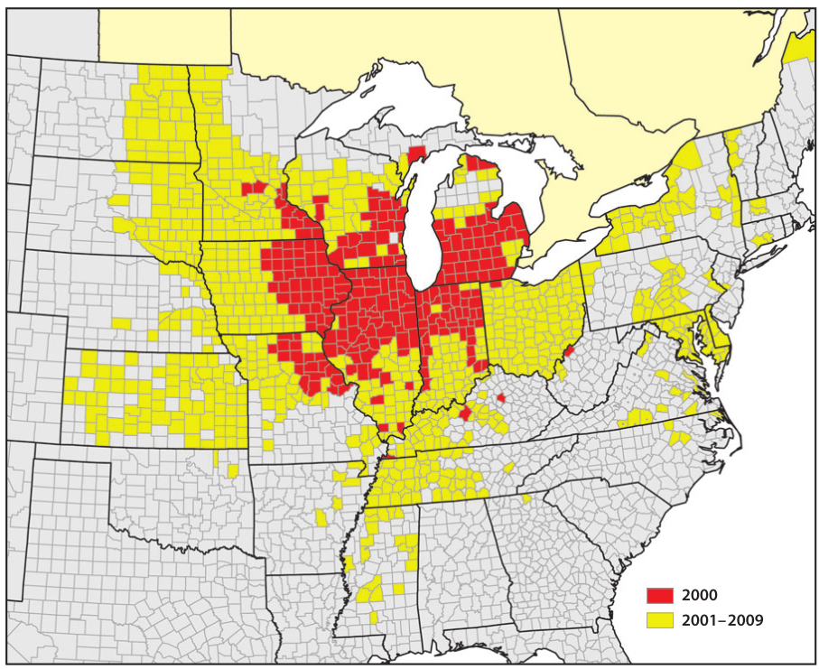
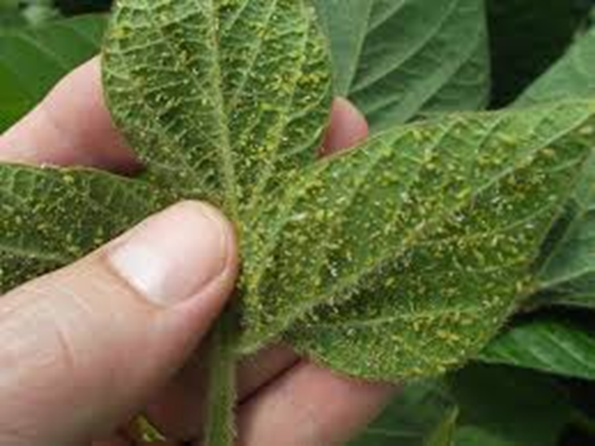
Soybean Aphid Detection Using Remote Sensing
Invasive species originating from Asia
Yield losses up to 40%
Spread of the soybean aphid in north central USA
Image credit: Ragsdale et al. 2011

Slide 21
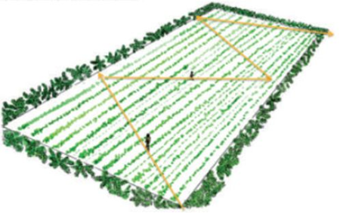
Remote Sensing as an Alternative to Crop Scouting for Soybean Aphids
Routine scouting of soybean fields for soybean aphid is time consuming and inefficient
  Soybean aphid outbreaks are erratic and timing can fluctuate
  Chemical management is only recommended when populations exceed 250 aphids per plant
  Scouting only assesses 20-40 plants in a field, leading to incomplete coverage
  Aphid populations can rapidly increase and cause yield loss, 84% of growers want to reduce scouting efforts
Remote sensing allows early detection of soybean aphids

Slide 22
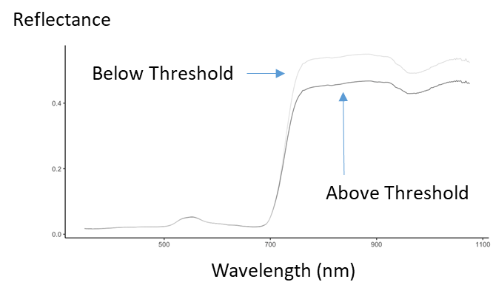
Remote Sensing for Soybean Aphids
Weekly imaging with a drone can accurately detect areas with aphid populations that exceed the economic threshold for spraying

Slide 23
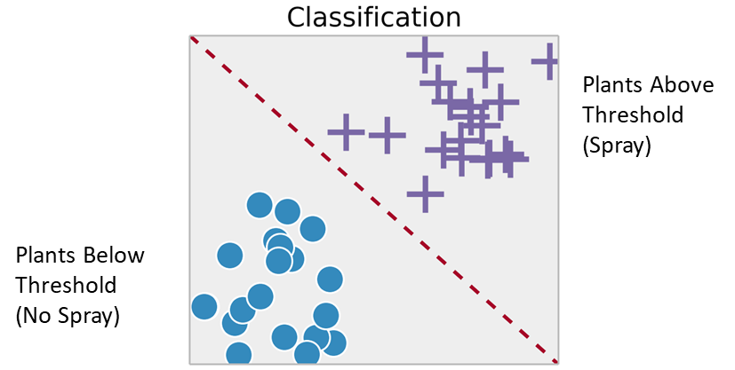
Remote Sensing Combined with Machine Learning Identifies Infestations Above Threshold
Drones can be used to scout entire fields for soybean aphids
Fields can be sprayed before aphids cause widespread crop damage

Slide 24
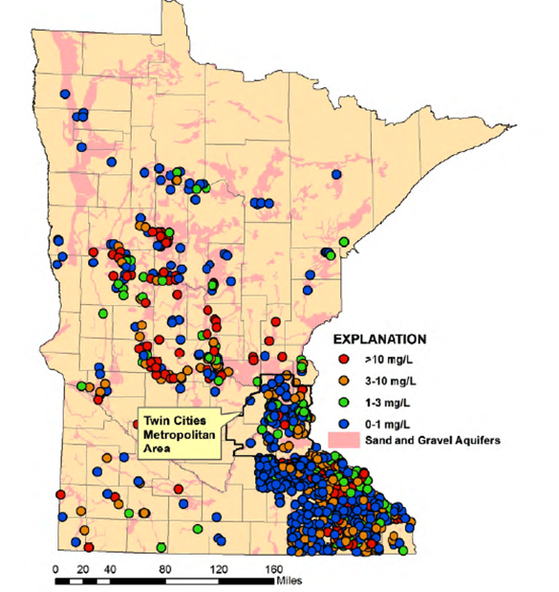
Groundwater Contamination with Nitrates
About 5-10% of private wells have NO₃- concentrations that exceed 10 mg/L
About 1% of public wells exceed 10 mg/L

Slide 25
N Fertilizer Management in Irrigated Corn/Potatoes
Corn and potatoes are produced in the irrigated Central Sands region of Minnesota
Nitrate leaching to groundwater is a concern
Research is underway to develop agricultural chemical best management practices that will prevent, minimize, reduce, and eliminate the source of groundwater degradation

Slide 26
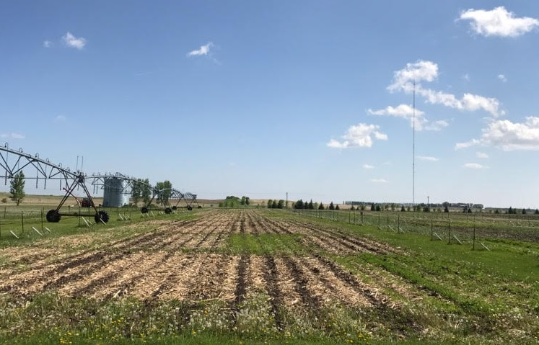
BMPs of Interest
Nitrogen fertilizer practices (rate, timing, splits, spoon feeding, etc.), forms of N (anhydrous, urea, slow release)
Water management practices (checkbook method, irrigation scheduling, variable rate irrigation)
Vegetative management practices (cover or catch crops, perennial crops, cropping systems)

Slide 27
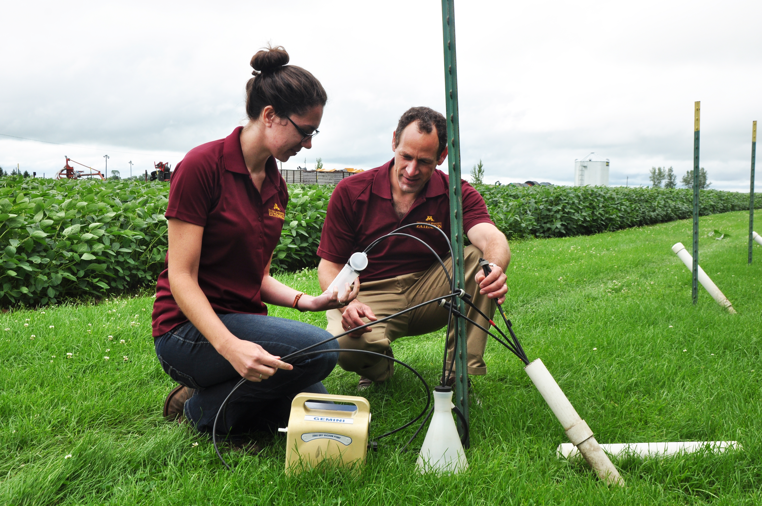
Irrigated Research Objectives at Westport, MN
To measure and model nitrate-N leaching losses on irrigated coarse textured soils with:
corn-corn (C-C), corn-soybean (C-Sb) and soybean-corn (Sb-C) rotations
N application rates on corn of 0, 100, 200, 250 and 300 kg N ha⁻¹ (two split applications)
Improved irrigation management strategies
With rye cover crop

Slide 28
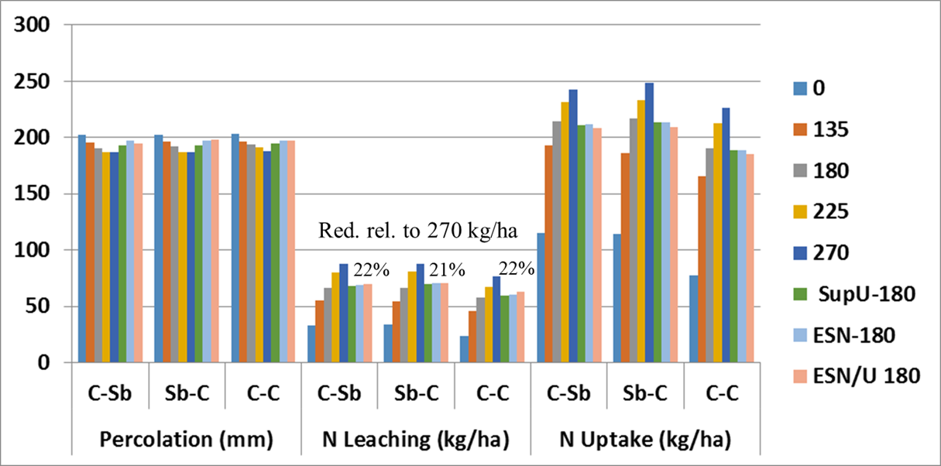
Percolation, N Leaching and Crop N Uptake
Reducing N rate by 33% and using slow release fertilizer reduces N loss by 21-22%, with small reductions in crop yield

Slide 29
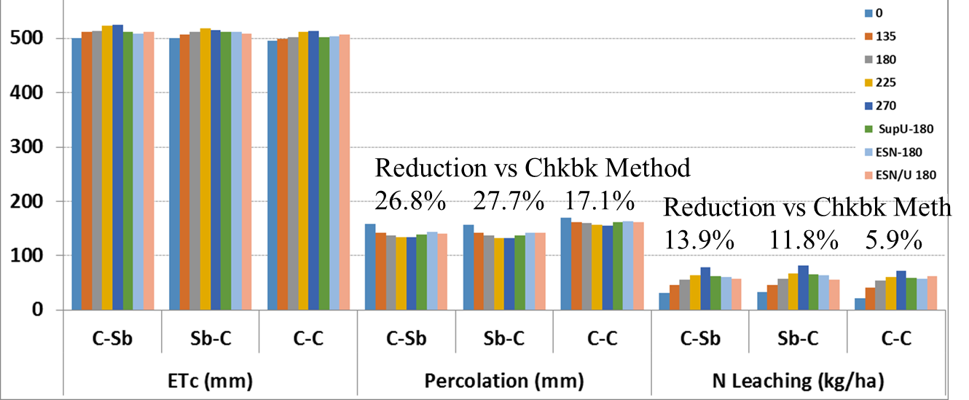
Improved Irrigation Reduces Percolation and N Leaching
Improved irrigation reduces N leaching by 6-14% relative to conventional irrigation

Slide 30
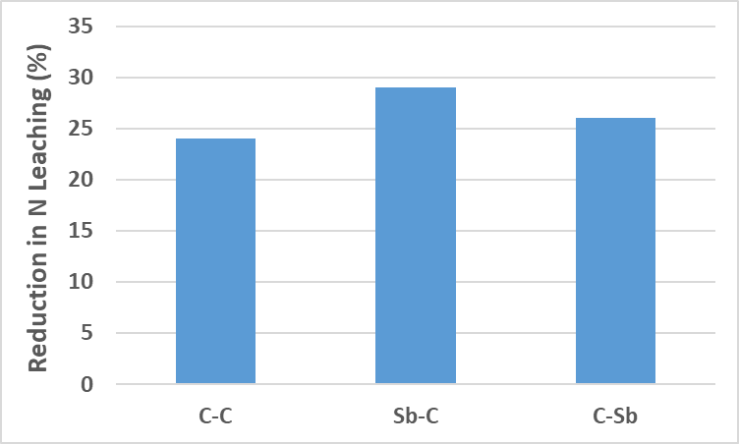
Impacts of Cover Crops on N Leaching Loss
Rye cover crops reduce N losses by about 25% relative to no cover crop
Higher N uptake occurs if rye is planted after soybeans (in the Sb-C rotation)
Reductions relative to no rye in the period
between harvest and planting of the main crop

Slide 31
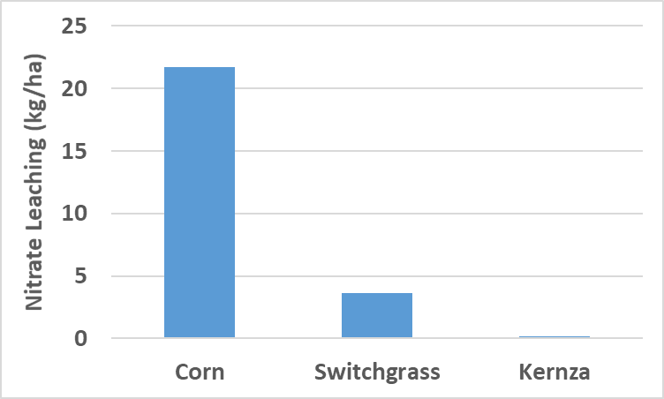
Impacts of Perennial Crops on Nitrate Loss
N leaching losses were 83% and 99% lower in switchgrass and Kernza©, compared with corn
Average of results from experiments at Crookston, Lamberton and Waseca

Slide 32
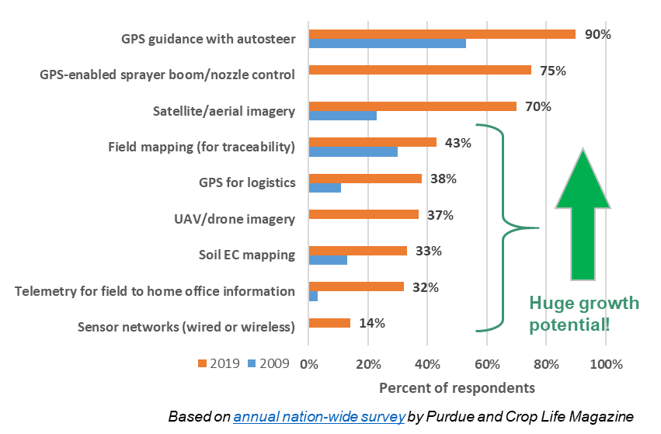
Impact of Precision Agriculture on Agribusiness
Precision Agriculture led to formation of hundreds of companies nationwide who provide services to growers
Local examples include SoilTeq, Farmer’s Edge, Geosys, Sentera, Sentek, EarthScout and Aglytix, with large portfolios by Land O’Lakes and CHS
These have large impacts on Minnesota jobs and workforce development and placement
“Our relationship with Professors David Mulla, Carl Rosen, Fabian Fernandez, and Daniel Kaiser
has and will continue to have a tangible impact both on technological development at Sentek
as well as on end-user applications revolving around our products.” Craig Poling, CTO Sentek

Slide 33
Federal and State Funds Leveraged
NSF National Robotics Initiative (NRI)
USDA Agriculture and Food Research Initiative (AFRI)
USDA Foundational Ag Engineering
NSF Cyber Innovation for Sustainability Sci. (SEES)
MDA (AFREC and Clean Water Research)
MN Corn, Soybean and Wheat commodity groups
CFANS investment in Variable Rate Irrigation at new Becker Sand Plain Research Farm
MN State Legislature
  MNDrive funding for faculty and graduate students
  AGREET funding for faculty

Slide 34
Extension and Outreach Activities
The University of Minnesota Extension has several ongoing programs that are very effective at delivering information about precision agriculture to nutrient management decision maker audiences
  Online and in-person delivery
  On-farm demonstrations
Our face to face programs are designed to reach a broad audience, including agribusiness professionals, growers, agency personnel and the public
  Ag Professionals transmit this training to thousands of growers

Slide 35
Specific Extension and Outreach Programs
Institute for Agricultural Professionals
  Crops and Pest Management Short Course (with MN Crop Production Retailers)
  Field School for Ag Professionals (hands on learning program)
  Research Updates for Ag Professionals
Nitrogen: Minnesota's Grand Challenge and Compelling Opportunity Conference Series for agribusiness professionals
Nutrient Management Conference
Nitrogen Smart, a training program intended to deliver the fundamental principles of nitrogen management mainly for farmer audiences to help them understand current issues related to nitrate in surface and ground water and enable them to make well informed choices to potentially address these issues
Best of the Best – joint UofM and NDSU program for the Red River Valley
In addition we reach audiences through regular and timely podcasts, blogs, and online short videos (YouTube) on targeted topics
Nutrient Management Extension webpages are mobile friendly
We extensively use social media channels to increase coverage

Slide 36
Benefits of Precision Agriculture
Increased profitability and reduced crop loss for growers
Increased efficiency of inputs (N fertilizer, pesticides, irrigation)
Protection of surface and ground water quality
Strong University – Industry and grower partnerships
Job creation and workforce development
Effective Extension and Outreach

Slide 37
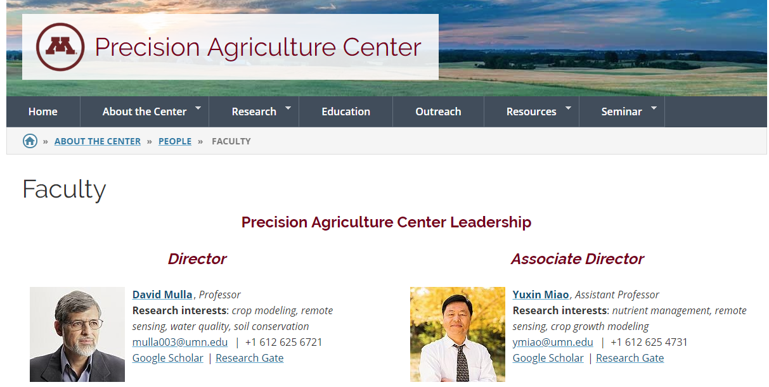
Thanks!
http://www.precisionag.umn.edu/
David Mulla
mulla003@umn.edu
(612) 625-6721

